Slide 1



Slide 2



01CE0503 - Design and Analysis of Algorithm
Unit - 4
Dynamic Programming
Prof. Jaydeep K. Ratanpara
Computer Engineering Department

Slide 3



OUTLINE
Introduction
Elements of Dynamic Programming
The Principle of Optimality
Problem Solving using Dynamic Programming –
Making Change Problem
Calculating the Binomial Coefficient
Assembly Line-Scheduling
Knapsack problem
Matrix chain multiplication
Longest Common Subsequence

Slide 4
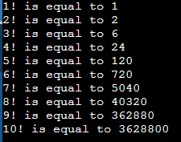
INTRODUCTION
int main()
{
int n = 10;
for(int i=1;i<=n;i++)
{
int factorial = 1;
for(int j=1;j<=i;j++)
{
factorial = factorial * j;
}
printf("\n%d! is equal to %d",i,factorial);
}
return 0;
} Time Complexity: ?
Output:

Slide 5
INTRODUCTION
int main()
{
int n = 10;
int fact[n];
fact[0]=1;
for(int i=1;i<=n;i++)
{
fact[i] = fact[i-1]*i;
printf("\n%d! is equal to %d",i,fact[i]);
}
return 0;
}
Time Complexity: ?

Slide 6
INTRODUCTION
Dynamic programming is a technique that breaks the problems into sub-problems, and saves the result for future purposes so that we do not need to compute the result again.
The subproblems are optimized to optimize the overall solution is known as optimal substructure property.
The main use of dynamic programming is to solve optimization problems.
Here, optimization problems mean that when we are trying to find out the minimum or the maximum solution of a problem.
The dynamic programming guarantees to find the optimal solution of a problem if the solution exists.

Slide 7
INTRODUCTION
How to Solve Making Change using Dynamic Programming?
Making Change problem is to find change for a given amount using a minimum number of coins from a set of denominations.
Explanation : If we are given a set of denominations D = {d₀, d₁, d₂, …, d_{n}} and if we want to change for some amount N, many combinations are possible. Suppose {d₁, d₂, d₅, d₈}, {d₀, d₂, d₄}, {d₀, d₅, d₇} all feasible solutions.
The aim of making a change is to find a solution with a minimum number of coins / denominations. Clearly, this is an optimization problem.

Slide 8
INTRODUCTION
Conventional / greedy approach selects largest denomination first which is not greater than remaining amount.
If current denomination is not possible to select then select second largest denomination and so on. Continue this process until solution is found.

Slide 9
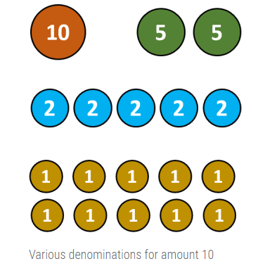
INTRODUCTION

Slide 10
INTRODUCTION
However this approach may fail to find best solution.
For example, suppose we have denominations {1, 4, 5} and if we want change for 8, then conventional or greedy approach returns four coins, <5, 1, 1, 1>, but optimal solution is <4, 4>.

Slide 11
PROPERTIES OF DYNAMIC PROGRAMMING
Properties of Dynamic programming
Overlapping Sub-problems
Optimal Substructure

Slide 12
PROPERTIES OF DYNAMIC PROGRAMMING
Overlapping Sub-problems
Similar to Divide-and-Conquer approach, Dynamic Programming also combines solutions to sub-problems.
It is mainly used where the solution of one sub-problem is needed repeatedly.
The computed solutions are stored in a table, so that these don’t have to be re-computed. Hence, this technique is needed where overlapping sub-problem exists.
For example, Binary Search does not have overlapping sub-problem. Whereas recursive program of Fibonacci numbers have many overlapping sub-problems.

Slide 13
PROPERTIES OF DYNAMIC PROGRAMMING
2. Optimal Substructure
A given problem has Optimal Substructure Property, if the optimal solution of the given problem can be obtained using optimal solutions of its sub-problems.
For example, the Shortest Path problem has the following optimal substructure property −
If a node x lies in the shortest path from a source node u to destination node v, then the shortest path from u to v is the combination of the shortest path from u to x, and the shortest path from x to v.

Slide 14
MAKING CHANGE PROBLEM
Example: Consider an instance of a problem with coins 1, 4 and 6 units. Illustrate its solutions using dynamic programming approach involving a payment of 8 units.
Mathematical Formulation
Sort all the denomination and start scanning from largest to smallest denomination. In every iteration i, if current denomination di is acceptable, then 1 coin is added in solution and total amount is reduced by amount di. Hence,
C[i, j] = 1 + (c [1, j – d1])

Slide 15
MAKING CHANGE PROBLEM
If current denomination is larger than current problem size, then we have to skip the denomination and stick with previously calculated solution. Hence,
C[i, j] = C[i – 1, j]
Our objective is to find minimum number of coins, so at each step, we have to stick with choice which returns minimum number of coin. Mathematically, we formulate the problem as,
C[i, j] = min {C[i – 1, j] , 1 + C[i, j – di]}

Slide 16
MAKING CHANGE PROBLEM
Where,
di = ith denomination ,1 ≤ i ≤ n
j = Size of sub problem
C[1…..n, 0…..N] = Size of the problem
C[n, N] = Solution of the problem
n = Number of denomination
N = Amount for which change is required By combining all three cases, we have
1. if i=1 then C[i,j] = 1 + C[1, j-d1]
2. if j<di then C[i,j] = C[i-1, j]
3. Otherwise c[i,j] = min{c[i-1,j], 1+c[i,j-di]}
Note: If no combination of coins sums to amount j, then C[i, j] = ∞

Slide 17
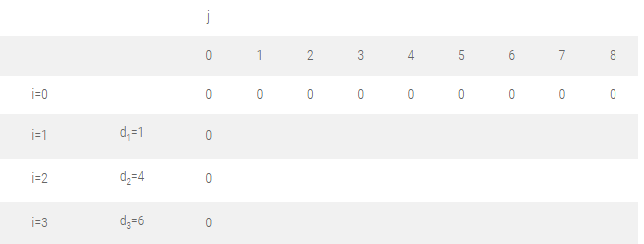
MAKING CHANGE PROBLEM
Let us find the optimal solution for D = {d₁, d₂, d₃} = {1, 4, 6} and N = 8.
Initialize the table C [i, 0] = 0 and C [0, j] = 0.
These indicate we don’t have any denomination and size of problem is zero respectively.

Slide 18
MAKING CHANGE PROBLEM
Filling first column, j = 1 :
C [1, 1] ⇒ i = 1, j = 1, d_{i} = d₁ = 1
As, i = 1, formula 1 is used
C [i, j] = C [1, 1] = 1 + C [1, j – d₁ ]
= 1 + C [1, 1 – 1]
= 1 + C [1, 0]
= 1
C [2, 1] ⇒ i = 2, j = 1, d_{i} = d₂ = 4
As, j < d₂, i.e. 1< 4
C [i, j] = C [2, 1] = C [i – 1, j] = C [1, 1] = 1
C [3, 1] ⇒ i = 3, j = 1, d_{i} = d₃ = 6
As, j < d₃,
C [3, 1] = C [i – 1, j]
= C[3-1,1]
= C [2, 1]
= 1
if i=1 then C[i,j] = 1 + C[1, j-d1]
if j<di then C[i,j] = C[i-1, j]
Otherwise c[i,j] = min{c[i-1,j], 1+c[i,j-di]}

Slide 19
MAKING CHANGE PROBLEM
Filling second column, j = 2 :
C [1, 2] ⇒ i = 1, j = 2, d_{i} = d₁ = 1
As, i = 1, formula 1 is used
C [i, j] = C [1, 2] = 1 + C [1, j – d₁]
= 1 + C [1, 2 – 1]
= 1 + C [1, 1]
= 1 + 1
= 2
C [2, 2] ⇒ i = 2, j = 2, d_{i} = d₂ = 4
As, j < d₂,
C [i, j] = C [2, 2] = C [i – 1, j]
= C [1, 2]
= 2
C [3, 2] ⇒ i = 3, j = 2, d_{i} = d₃ = 6
As, j < d₃,
C [i, j] = C [3, 2] = C [i – 1, j]
= C [2, 2]
= 2
if i=1 then C[i,j] = 1 + C[1, j-d1]
if j<di then C[i,j] = C[i-1, j]
Otherwise c[i,j] = min{c[i-1,j], 1+c[i,j-di]}

Slide 20
MAKING CHANGE PROBLEM
Filling third column, j = 3 :
C [1, 3] ⇒ i = 1, j = 3, d_{i} = d₁ = 1
As, i = 1, formula 1 is used
C [i, j] = 1 + C [1, j – d₁ ]
= 1 + C [1, 3 – 1]
= 1 + C [1, 2]
= 1 + 2
= 3
C [2, 3] ⇒ i = 2, j = 3, d_{i} = d₂ = 4
As, j < d_{i},
C [i, j] = C [2, 3] = C [i – 1, j]
= C [1, 3]
= 3
C [3, 3] ⇒ i = 3, j = 3, d_{i} = d₃ = 6
As, j < d_{i},
C [i, j] = C[3,3] = C [i – 1, j]
= C [2, 3]
= 3
if i=1 then C[i,j] = 1 + C[1, j-d1]
if j<di then C[i,j] = C[i-1, j]
Otherwise c[i,j] = min{c[i-1,j], 1+c[i,j-di]}

Slide 21
MAKING CHANGE PROBLEM
Filling fourth column, j = 4 :
C [1, 4] ⇒ i = 1, j = 4, d_{i} = d₁ = 1
As, i = 1 formula 1 is used
C [i, j] = 1 + C [1, j – d₁]
C [1, 4] = 1 + C [1, 4 – 1]
= 1 + C [1, 3]
= 1 + 3
= 4
C [2, 4] ⇒ i = 2, j = 4, d_{i} = d₂ = 4
As i ≠ 1 and j ≥ d_{i}
C [i, j] = min { C [i – 1, j], 1 + C [i, j – d_{i}] }
C [2, 4] = min { C [1, 4], 1 + C [2, 4 – 4] }
= min { C [1, 4], 1 + C [2, 0] }
= min {4, 1 + 0}
= 1
C [3, 4] ⇒ i = 3, j = 4, d_{i} = d₃ = 6
As j < d_{i},
C [i, j] = C [i – 1, j]
C [3, 4] = C [2, 4]
= 1
if i=1 then C[i,j] = 1 + C[1, j-d1]
if j<di then C[i,j] = C[i-1, j]
Otherwise c[i,j] = min{c[i-1,j], 1+c[i,j-di]}

Slide 22
MAKING CHANGE PROBLEM
Filling fifth column, j = 5 :
C [1, 5] ⇒ i = 1, j = 5, d_{i} = d₁ = 1
As, i = 1 formula 1 is used
C [i, j] = 1 + C [1, j – d₁]
= 1 + C [1, 5 – 1]
= 1 + C [1, 4]
= 1 + 4
= 5
C [2, 5] ⇒ i = 2, j = 5, d_{i} = d₂ = 4
As i ≠ 1 and j ≥ d_{i} , So,
C [i, j] = min { C [i – 1, j], 1 + C [i, j – d_{i}] }
= min { C [1, 5], 1 + C [2, 1] }
= min {5, 1 + 1}
= 2
C [3, 5] ⇒ i = 3, j = 5, d_{i} = d₃ = 6
As j < d_{i},
C [i, j] = C [i – 1, j]
C [3, 5] = C [2, 5]
= 2
if i=1 then C[i,j] = 1 + C[1, j-d1]
if j<di then C[i,j] = C[i-1, j]
Otherwise c[i,j] = min{c[i-1,j], 1+c[i,j-di]}

Slide 23
MAKING CHANGE PROBLEM
Filling sixth column, j = 6 :
C [1, 6] ⇒ i = 1, j = 6, d_{i} = d₁ = 1
As, i = 1formula 1 is used
C [i, j] = 1 + C [1, j – d₁]
= 1 + C [1, 5]
= 1 + 5
= 6
C [2, 6] ⇒ i = 2, j = 6, d_{i} = d₂ = 4
As i ≠ 1 and j ≥ d_{i}
C [i, j] = min { C [i – 1, j], 1 + C [i, j – d_{i}] }
= min { C [1, 6], 1 + C [2, 2] }
= min {6, 1 + 2}
= 3
C [3, 6] ⇒ i = 3, j = 6, d_{i} = d₃ = 6
As i ≠ 1 and j ≥ d_{i}
C [i, j] = min { C [i – 1, j], 1 + C [i, j – d_{i}] }
= min { C [2, 6], 1 + C [3, 0] }
= min {6, 1 + 0}
= 1
if i=1 then C[i,j] = 1 + C[1, j-d1]
if j<di then C[i,j] = C[i-1, j]
Otherwise c[i,j] = min{c[i-1,j], 1+c[i,j-di]}

Slide 24
MAKING CHANGE PROBLEM
Filling seventh column, j = 7 :
C [1, 7] ⇒ i = 1, j = 7, d_{i} = d₁ = 1
As, i = 1 formula 1 is used
C [i, j] = 1 + C [i, j – d_{i}]
= 1 + C [1, 6]
= 1 + 6
= 7
C [2, 7] ⇒ i = 2, j = 7, d_{i} = d₂ = 4
As i ≠ 1 and j ≥ d_{i}
C [i, j] = min { C [i – 1, j], 1 + C [i, j – d_{i}] }
= min { C [1, 7], 1 + C [2, 3] }
= min {7, 1 + 3}
= 4
C [3, 7] ⇒ i = 3, j = 7, d_{i} = d₃ = 6
As i ≠ 1 and j ≥ d_{i}
C [i, j] = min { C [i – 1, j], 1 + C [i, j – d_{i}] }
= min { C [2, 7], 1 + C [3, 17] }
= min {4, 2}
= 2
if i=1 then C[i,j] = 1 + C[1, j-d1]
if j<di then C[i,j] = C[i-1, j]
Otherwise c[i,j] = min{c[i-1,j], 1+c[i,j-di]}

Slide 25
MAKING CHANGE PROBLEM
Filling eighth column, j = 8 :
C [1, 8] ⇒ i = 1, j = 8, d_{i} = d₁ = 1
As, i = 1 formula 1 is used
C [i, j] = 1 + C [i, j – d_{i}]
= 1 + C [1, 7]
= 1 + 7
= 8
C [2, 8] ⇒ i = 2, j = 8, d_{i} = d₂ = 4
As i ≠ 1 and j ≥ d_{i}
C [i, j] = min { C [i – 1, j], 1 + C [i, j – d_{i}] }
= min { C [1, 8], 1 + C [2, 4] }
= min {8, 1 + 1}
= 2
C [3, 8] ⇒ i = 3, j = 8, d_{i} = d₃ = 6
As i ≠ 1 and j ≥ d_{i}
C [i, j] = min { C [i – 1, j], 1 + C [i, j – d_{i}]
= min { C [2, 8], 1 + C [3, 2] }
= min {2, 1 + 2}
= 2
if i=1 then C[i,j] = 1 + C[1, j-d1]
if j<di then C[i,j] = C[i-1, j]
Otherwise c[i,j] = min{c[i-1,j], 1+c[i,j-di]}

Slide 26
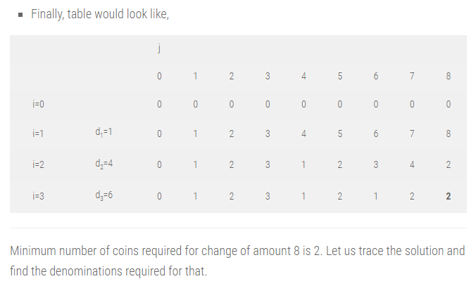
MAKING CHANGE PROBLEM

Slide 27
MAKING CHANGE PROBLEM
TRACING SOLUTION:
For last cell in table, i and j would be 3 and 8 respectively.
C[n, N] = C[i, j] = C[3, 8] = 2
Step 1 : (i = 3, j = 8) : C[3, 8] = 2 and C[2, 8] = 2
Here, C[i, j] = C[i – 1, j], implies nothing was added in previous solution.
Algorithm has propagated the solution of previous iteration in current iteration.
So go to previous step by reducing i. So, i = i – 1 = 3 – 1 = 2

Slide 28
MAKING CHANGE PROBLEM
Step 2 : (i = 2, j = 8) : C[2, 8] = 2 and C[1, 8] = 8
Here, C[i, j] ≠ C[i – 1, j], implies denomination d_{i} = d₂ = 4 was added in previous solution.
So add d_{i} in solution set and reduce problem size j by d_{i}.
Solution set S = {4}, j = j – d_{i} = 8 – 4 = 4.
Now we have, i = 2 and j = 4.

Slide 29
MAKING CHANGE PROBLEM
Step 3 : (i = 2, j = 4) : C[2, 4] = 1 and C[1, 4] = 4
Here, C[i, j] ≠ C[i – 1, j], implies denomination d_{i} = d₂ = 4 was added in previous solution.
So add d_{i} in solution set and reduce problem size j by d_{i}.
Solution set S = {4, 4}, j = j – d_{i} = 4 – 4 = 0.
Problem size j is zero. So stop.
We need two coins of amount 4 for optimal change of amount 8.

Slide 30
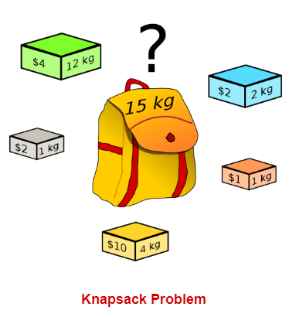
KNAPSACK PROBLEM

Slide 31
KNAPSACK PROBLEM
Problem : Given a set of items, each having different weight and value or profit associated with it. Find the set of items such that the total weight is less than or equal to a capacity of the knapsack and the total value earned is as large as possible.
The knapsack problem is useful in solving resource allocation problem.
Let X = < x₁, x₂, x₃, . . . . . , x_{n}> be the set of n items. Sets W = <w₁, w₂, w₃, . . . , w_{n}> and V = < v₁, v₂, v₃, . . . , v_{n}> are weight and value (profit) associated with each item in X. Knapsack capacity is M unit.
The knapsack problem is to find the set of items which maximizes the profit such that collective weight of selected items does not cross the knapsack capacity.
Knapsack problem has two variations. 0/1 knapsack, that does not allow breaking of items. Either add an entire item or reject it. It is also known as a binary knapsack. Fractional knapsack allows breaking of items.

Slide 32
KNAPSACK PROBLEM
Mathematical formulation :
We can select any item only ones.
We can put items x_{i} in knapsack if knapsack can accommodate it.
If the item is added to a knapsack, the associated profit is accumulated.
If the weight of the item is larger than the remaining knapsack capacity, we skip the item, and the solution of the previous step remains as it is.
Otherwise, we should add the item to the solution set and the problem size will be reduced by the weight of that item.
Corresponding profit will be added for the selected item.

Slide 33
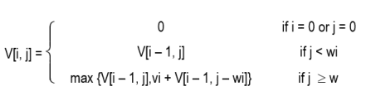
KNAPSACK PROBLEM
Mathematical formulation :
Dynamic programming divides the problem into small sub-problems.
Let V is an array of the solution of sub-problems.
V[i, j] represents the solution for problem size j with first i items.
The mathematical notion of the knapsack problem is given as :
V [1 …. n, 0 … M] : Size of the table
V (n, M) = Solution
n = Number of items

Slide 34
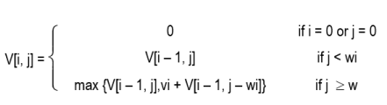
KNAPSACK PROBLEM
Example: Find an optimal solution for following 0/1 Knapsack problem using dynamic programming: Number of objects n = 4, Knapsack Capacity M = 5, Weights (W1, W2, W3, W4) = (2, 3, 4, 5) and profits (P1, P2, P3, P4) = (3, 4, 5, 6).
Solution: Solution of the knapsack problem is defined as,

Slide 35
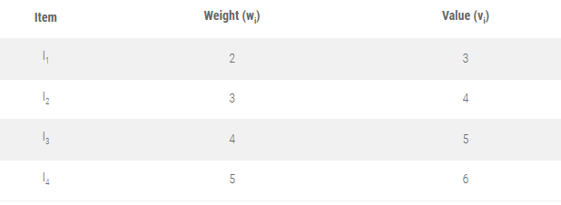
KNAPSACK PROBLEM

Slide 36
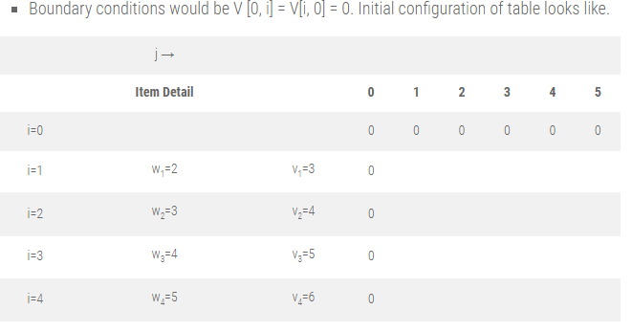
KNAPSACK PROBLEM

Slide 37
MAKING CHANGE PROBLEM
Filling first column, j = 1
V [1, 1] ⇒ i = 1, j = 1, w_{i} = w₁ = 2
As, j < w_{i},
V [i, j] = V [i – 1, j]
V [1, 1] = V [0, 1]
= 0
V [2, 1] ⇒ i = 2, j = 1, w_{i} = w₂ = 3
As, j < w_{i},
V [i, j] = V [i – 1, j]
V [2, 1] = V [1, 1]
= 0
V [3, 1] ⇒ i = 3, j = 1, w_{i} = w₃ = 4
As, j < w_{i},
V [i, j] = V [i – 1, j]
V [3, 1] = V [2, 1] = 0
V [4, 1] ⇒ i = 4, j = 1, w_{i} = w₄ = 5
As, j < w_{i},
V[i, j] = V[i – 1, j]
V [4, 1] = V [3, 1] = 0

Slide 38
MAKING CHANGE PROBLEM
Filling first column, j = 2
V[1, 2] ⇒ i = 1, j = 2, w_{i} = w₁ = 2, v_{i} = 3
As, j ≥ w_{i},
V [i, j] =max {V [i – 1, j], v_{i} + V[i – 1, j – w_{i}] }
= max {V [0, 2], 3 + V [0, 0]}
V[1, 2] = max (0, 3)
= 3
V[2, 2] ⇒ i = 2, j = 2, w_{i} = w₂ = 3, v_{i} = 4
As, j < w_{i},
V [i, j] = V[i – 1, j]
V[2, 2] = V[1, 2]
= 3
V[3, 2] ⇒ i = 3, j = 2, w_{i} = w₃ = 4, v_{i} = 5
As, j < w_{i},
V[i, j] = V[i – 1, j]
V[3, 2] = V [2, 2] = 3
V[4, 2] ⇒ i = 4, j = 2, w_{i} = w₄ = 5, v_{i} = 6
As, j < w_{i}, V[i, j] = V[i – 1, j]
V[4, 2] = V[3, 2] = 3

Slide 39
MAKING CHANGE PROBLEM
Filling first column, j = 3
V[1, 3] ⇒ i = 1, j = 3, w_{i} = w₁ = 2, v_{i} = 3
As, j ≥ w_{i},
V [i, j] =max {V [i – 1, j], v_{i} + V [i – 1, j – w_{i}] }
= max {V [0, 3], 3 + V [0, 1]}
V[1, 3] = max (0, 3) = 3
V[2, 3] ⇒ i = 2, j = 3, w_{i} = w₂ = 3, v_{i} = 4
As, j ≥ w_{i},
V [i, j] = max {V [i – 1, j], v_{i} + V [i – 1, j – w_{i}] }
= max {V [1, 3], 4 + V [1, 0]}
V[2, 3] = max (3, 4) = 4
V[3, 3] ⇒ i = 3, j = 3, w_{i} = w₃ = 4, v_{i} = 5
As, j < w_{i},
V [i, j] = V [i – 1, j]
V[3, 3] = V [2, 3] = 4
V[4, 3] ⇒ i = 4, j = 3, w_{i} = w₄ = 5, v_{i} = 6
As, j < w_{i},
V[i, j] = V[i – 1, j]
V[4, 3] = V [3, 3] = 4

Slide 40
MAKING CHANGE PROBLEM
Filling first column, j = 4
V[1, 4] ⇒ i = 1, j = 4, w_{i} = w₁ = 2, v_{i} = 3
As, j ≥ w_{i},
V [i, j] = max {V [i – 1, j], v_{i} + V [i – 1, j – w_{i}] }
= max {V [0, 4], 3 + V [0, 2]}
V[1, 4] = max (0, 3) = 3
V[2, 4] ⇒ i = 2, j = 4, w_{i} = w₂ = 3 , v_{i} = 4
As, j ≥ w_{i},
V [i, j] = max {V [i – 1, j], v_{i} + V [i – 1, j – w_{i}] }
= max {V [1, 4], 4 + V [1, 1]}
V[2, 4] = max (3, 4 + 0) = 4
V[3, 4] ⇒ i = 3, j = 4, w_{i} = w₃ = 4, v_{i} = 5
As, j ≥ w_{i},
V [i, j] =max {V [i – 1, j], v_{i} + V [i – 1, j – w_{i}] }
=max {V [2, 4], 5 + V [2, 0]}
V[3, 4] =max (4, 5 + 0) = 5
V[4, 4] ⇒ i = 4, j = 4, w_{i} = w₄ = 5, v_{i} = 6
As, j < w_{i},
V [i, j] = V [i – 1, j]
V[4, 4] = V [3, 4] = 5

Slide 41
MAKING CHANGE PROBLEM
Filling first column, j = 5
V [1, 5] ⇒ i = 1, j = 5, w_{i} = w₁ = 2, v_{i} = 3
As, j ≥ w_{i},
V [i, j] = max {V [i – 1, j], v_{i} + V [i – 1, j – w_{i}] }
= max {V [0, 5], 3 + V [0, 3]}
V[1, 5] = max (0, 3) = 3
V[2, 5] ⇒ i = 2, j = 5, w_{i} = w₂ = 3, v_{i} = 4
As, j ≥ w_{i},
V [i, j] = max {V [i – 1, j], v_{i} + V [i – 1, j – w_{i}] }
= max {V [1, 5], 4 + V [1, 2]}
V[2, 5]= max (3, 4 + 3) = 7
V[3, 5] ⇒ i = 3, j = 5, w_{i} = w₃ = 4, v_{i} = 5
As, j ≥ w_{i},
V [i, j] = max {V [i – 1, j], v_{i} + V [i – 1, j – w_{i}] }
= max {V [2, 5], 5 + V [2, 1]}
V[3, 5] = max (7, 5 + 0) = 7
V [4, 5] ⇒ i = 4, j = 5, w_{i} = w₄ =5, v_{i} = 6
As, j ≥ w_{i},
V [i, j] = max {V [i – 1, j], v_{i} + V [i – 1, j – w_{i}] }
= max {V [3, 5], 6 + V [3, 0]}
V[4, 5] = max (7, 6 + 0) = 7

Slide 42
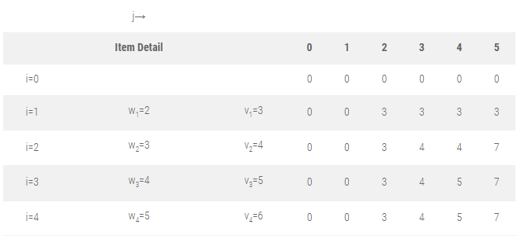
KNAPSACK PROBLEM

Slide 43
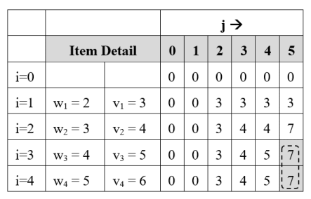
KNAPSACK PROBLEM
Find selected items for M = 5
Step 1 : Initially, i = n = 4, j = M = 5

Slide 44
KNAPSACK PROBLEM
Find selected items for M = 5
Step 1 : Initially, i = n = 4, j = M = 5
V[i, j] = V[4, 5] = 7
V[i – 1, j] = V[3, 5] = 7
V[i, j] = V[i – 1, j],
so don’t select i^{th} item and check for the previous item.
so i = i – 1 = 4 – 1 = 3
Solution Set S = { }

Slide 45
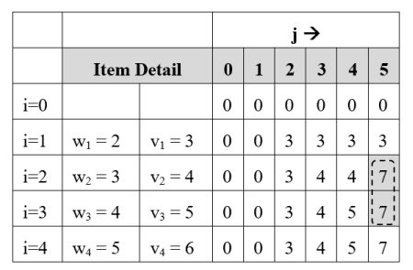
KNAPSACK PROBLEM
Step 2 : i = 3, j = 5
V[i, j] = V[3, 5] = 7
V[i – 1, j] = V[2, 5] = 7
V[i, j] = V[i – 1, j],
so don’t select i^{th} item and check for the previous item.
so i = i – 1 = 3 – 1 = 2
Solution Set S = { }

Slide 46
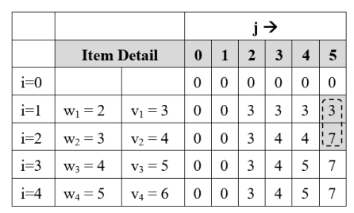
KNAPSACK PROBLEM
Step 3 : i = 2, j = 5
V[i, j] = V[2, 5] = 7
V[i – 1, j] = V[1, 5] = 3
V[i, j] ≠ V[i – 1, j],
so add item Ii = I₂ in solution set.
Reduce problem size j by w_{i}
j = j – w_{i} = j – w₂ = 5 – 3 = 2
i = i – 1 = 2 – 1 = 1
Solution Set S = {I₂}

Slide 47
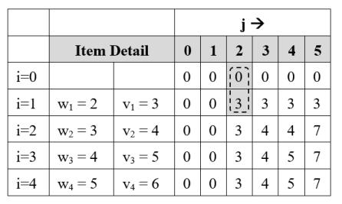
KNAPSACK PROBLEM
Step 4 : i = 1, j = 2
V[1, j] = V[1, 2] = 3
V[i – 1, j] = V[0, 2] = 0
V[i, j] ≠ V[i – 1, j],
so add item Ii = I₁ in solution set.
Reduce problem size j by w_{i}
j = j – w_{i} = j – w₁ = 2 – 2 = 0
Solution Set S = {I₁, I₂}
Problem size has reached to 0,
so final solution is
S = {I₁, I₂} Earned profit = P₁ + P₂ = 7

Slide 48

BINOMIAL CO-EFFICIENT
Computing binomial coefficient is very fundamental problem of mathematics and computer science.
Binomial coefficient C(n, k) defines coefficient of the term x^{k} in the expansion of (1 + x)^{n}.
C(n, k) also defines the number of ways to select any k items out of n items.
Many sub problems are called again and again, since they have an overlapping sub problems property.
Re-computations of the same sub problems is avoided by storing their results in the temporary array C[i, j.
The optimal substructure for using dynamic programming is stated as,

Slide 49
BINOMIAL CO-EFFICIENT
Formula of Binomial Co-efficient:
C (n, k) = C (n-1, k-1 ) + C (n-1, k) ;
C(n, 0) = 1
C(n, n) = 1
Where n > k > 0

Slide 50
BINOMIAL CO-EFFICIENT
Example : Calculate : C(4, 2)
C(4,2) = C (3, 1) + C(3, 2) ----------------------------(1)
Let’s calculate first C(3, 1)
C(3, 1) = C(2, 0) + C(2, 1)
= 1 + C(1, 0) + C(1, 1)
= 1 + 1 + 1
= 3 ---------------------------------------------- (2)
Now let’s calculate C(3, 2)
C(3, 2) = C(2, 1) + C(2, 2)
= C(1, 0) + C(1, 1) + 1
= 1+ 1+ 1
= 3 ----- (3)
Put value of (2) and (3) into (1)
C(4,2) = C (3, 1) + C(3, 2) ----(1)
= 3 + 3
= 6

Slide 51
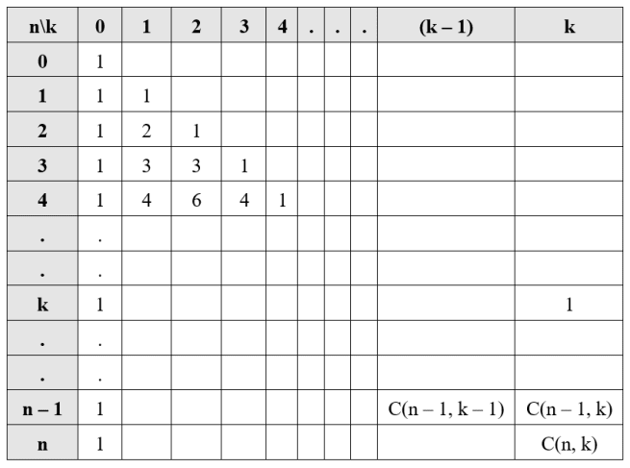
BINOMIAL CO-EFFICIENT
This tabular representation of binomial coefficients is also known as Pascal’s triangle.

Slide 52
BINOMIAL CO-EFFICIENT
Example 2. Calculate : C(5, 2)
Example 3. Calculate : C(6, 3)

